Slide 1

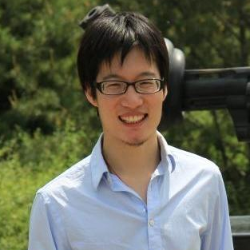
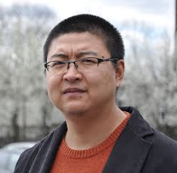
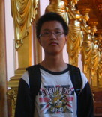
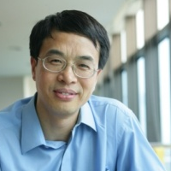
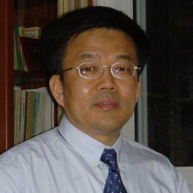

FEMA: Flexible evolutionary Multi-faceted analysis for dynamic behavior pattern Discovery
Meng Jiang, Tsinghua University, Beijing, China
Joint work with Peng Cui, Fei Wang, Xinran Xu, Wenwu Zhu and Shiqiang Yang
August 25, 2014 – NYC, USA
Notes:
Hello everyone, welcome to listen to our work. My name is Meng Jiang. I am from Tsinghua University in Beijing. I am introducing you our framework FEMA – flexible evolutionary multi-faceted analysis for dynamic behavior pattern discovery. This is a joint work with Peng Cui, Fei Wang, Xinran Xu, Wenwu Zhu and Shiqiang Yang.

Slide 2



Behavior Analysis
Modeling
How to formulate human behavior?
Pattern discovery
How to understand human behavior?
Prediction
What is the missing human behavior?
KDD’13
?
KDD’14
Notes:
Behavioral data analysis is important in both industry and scientific research. What we human beings do every day is creating behavioral data. For example, we researchers write papers. So, we have DBLP and Google Scholar data. We post photos and messages on social networks. So, we have Facebook data. How to understand the huge behavioral data sequences is important. It needs three modules. The first is behavior modeling. For example, how to formulate the behaviors of a researcher who publish papers in KDD 2013 and 2014? \\
Our final goal is usually behavior prediction. Based on the historical data, what is his next paper? Our prediction should be based on the understanding of his behaviors. \\
From his previous papers, we can know he is interested in data mining area. So, perhaps he will submit papers to KDD 2015 or TKDD journal. With all these 3 modules, we need an effective and efficient framework to process the data.

Slide 3
Our Goals
Given: Behavioral data sequence
Find: A general framework that fast and best fit the behavioral data
Goals:
G1. Model the human behavior
G2. Understand the hidden patterns
G3. Predict the missing behavior
Notes:
Here I list our goals. Given us a large behavioral data sequence, \\
we want a general framework that can fast and best fit the data. \\
Our goals are clear. First, the framework should give a nice representation of human behavior. \\
Second, it should be able to capture the hidden patterns in human behaviors. \\
And the third, it should be able to predict the missing behaviors accurately and fast.

Slide 4
Outline
1. Background
2. Model Formulation
3. The Framework
4. Experiments
5. Visualization
Notes:
Here is the outline of this talk. First I will give the background. Then I will talk about model formulation and the framework FEMA. Then I will give the experimental results and visualizations.\\
Let’s first take a look at the background.

Slide 5
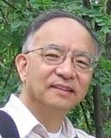



Human Behavior
Write a paper/book
Post a photo on Facebook
+
+
Notes:
Usually we describe human behavior as links between two types of nodes. When we talk about writing-paper behavior, we focus on the researcher and the article, like Prof. Jiawei Han and his book Mining Heterogeneous Information Networks.
About posting photos on Facebook, we focus on the user and the image, like me and my photo of Sheraton Hotel. As we know, most of the previous approaches model human behaviors into two dimensions.

Slide 6




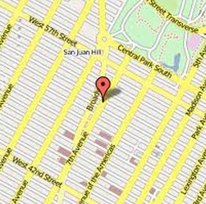

Human Behavior: Multi-faceted
Write a paper/book
Post a photo on Facebook
{
+
}
+
+
{
+
}
+
+
+
+
Notes:
However, human behavior is actually multi-faceted. To write a paper or book, researchers have their co-authors and group or department or university. \\
The book about heterogeneous information network was written by Prof. Jiawei Han and his student Yizhou Sun when they were in the Data Mining Group of UIUC. \\
Also, I am attending KDD with my advisor Prof. Peng Cui so when I post a photo on Facebook about Sheraton Hotel, I will tag him or say “with him”. \\
The message will be sent from my cellphone. \\
It shows my check-in at Sheraton and my comment “it is so nice”. \\
So, we believe human behavior should be modeled into multiple dimensions.

Slide 7


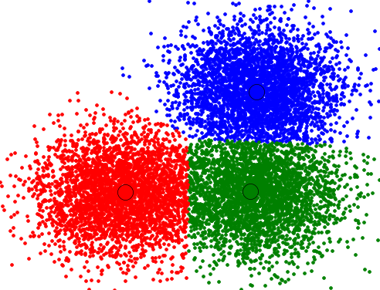
Human Behavior: Dynamic
Write a paper/book
time
time
DB
time
Notes:
Another important feature of human behavior is its dynamic pattern. Our behavior evolves over time. \\
For example, when Prof. Jiawei Han was in Simon Fraser, he published papers about database. \\
When he moved to UIUC, he focused on data clustering. \\
Later when Yizhou joined his group, they worked on heterogeneous information networks. \\
They have many papers of big impact in every topic, but we can clearly see the evolution of their research.

Slide 8
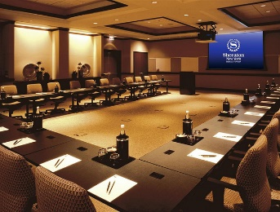
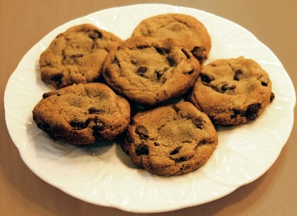
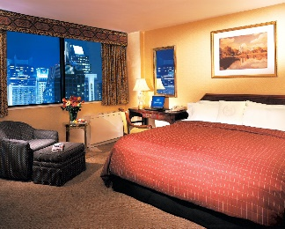
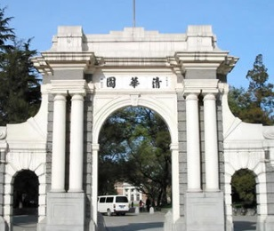


Human Behavior: Dynamic
Post Facebook messages
Hour
talk
tea break
travel
sleep
time
Month
Tsinghua
WWW’14
Tsinghua
KDD’14
time
Notes:
Our Facebook messages also change over time. Every day here I am in KDD, I post photos of the talks, tea break and travelling in New York at different time. \\
In different months this year, I post photos about my life in different places, such as Seoul in April for WWW, Tsinghua in June and July and here in New York for KDD.

Slide 9
Human Behavior
Multi-faceted
Dynamic
How to model human behavior?
Notes:
So now we notice that human behavior is multi-faceted and dynamic. How can we find a nice representation to formulate it?

Slide 10
Outline
1. Background
2. Model Formulation
3. The Framework
4. Experiments
5. Visualization
Notes:
Now let’s see the formulation.

Slide 11
Model Human Behavior
time
Human behavior
affiliation
keyword
author
Problem
Tensor sequence
Multi-faceted
Behavior modeling
Dynamic
Pattern discovery
Decomposition
Completion
Behavior prediction
≈
x
x
Notes:
With human behavioral data, we want to solve these problems, \\
first, behavior modeling, \\
second, pattern discovery, \\
and third, behavior prediction. \\
Behavior is multi-faceted, so we can use high-order tensors to model it. Behavior is dynamic, so we have a large sequence of tensors. \\
Then we can decompose the tensors for pattern discovery and do tensor completion to predict the missing values.

Slide 12
Challenges
High sparsity
High-order tensors
High complexity
Long sequence of tensors
Too slow if decomposing at each time
time
t₃
t₂
item
t₁
user
Notes:
The formulation is intuitive but we have to face two big challenges. \\
First is the high sparsity of high-order tensors. \\
Second is the high complexity. It costs too much time if we decompose each tensor from the long sequence at each time.

Slide 13
Idea
High sparsity
Auxiliary knowledge as regularizations
user
item
…
user
item
time
t₃
t₂
time
item
t₃
t₁
user
t₂
item
t₁
user
Notes:
Our idea is to use auxiliary knowledge as regularizations to solve the high sparsity problem. \\
Co-authorship data may help us to understand writing-paper behaviors. Social relations may help us to understand posting-message behaviors on Facebook.

Slide 14
Idea
High complexity
Update projection matrices with new coming piece of data
user
item
…
user
item
time
t₃
t₂
item
item
time
t₁
user
user
t₁
t₂
t₃
Notes:
It’s too slow to update and decompose tensors for projection matrices again and again. \\
To solve the high complexity problem, we want to update projection matrices with new coming pieces of data. \\\
The framework should be evolutionary and should incorporate regularizations.

Slide 15
Outline
1. Background
2. Model Formulation
3. The Framework
4. Experiments
5. Visualization
Notes:
Now let me show our framework FEMA.

Slide 16
FEMA: Flexible Evolutionary Multi-faceted Analysis
0~t
Δt
0~(t+Δt)
X
+
ΔX
item
item
user
√
user
×
matricizing
update
item
cluster
λ
core tensor
X⁽¹⁾
user
cluster
user
decompose
user
cluster
X⁽²⁾
A⁽¹⁾
item
user
projection matrix
item
cluster
L⁽¹⁾
L⁽²⁾
user
item
A⁽²⁾
regularize
item
user
item
Notes:
Given us a tensor, previous approaches, like Prof. Jimeng Sun’s DTA, dynamic tensor analysis in KDD 2008, introduce how to decompose it. \\
First, we do matricizing – turn the tensor into multiple matrices. \\
Second, we decompose them into core tensor and projection matrices. The projection matrices give us clusters in different dimensions. \\
Here we incorporate regularizations before the decomposition. \\
If the tensor is continuously updated, DTA decomposes the matricized tensor again after it’s updated. \\
We noticed that this step would cost lots of time. So, we propose FEMA, a novel framework to update core tensors and projection matrices with the new coming data. The hypothesis is that the new coming data is much smaller than historical data.

Slide 17
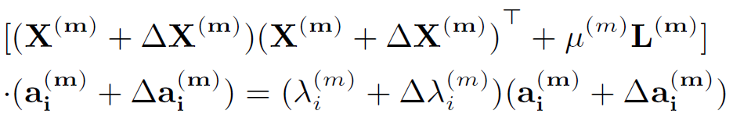
FEMA: Flexible Evolutionary Multi-faceted Analysis
0~t
Δt
0~(t+Δt)
X
+
ΔX
item
item
user
√
user
×
matricizing
update
item
cluster
λ
core tensor
user
cluster
Tensor Perturbation Theory
X⁽¹⁾
user
decompose
user
cluster
X⁽²⁾
A⁽¹⁾
item
user
projection matrix
item
cluster
L⁽¹⁾
L⁽²⁾
user
item
A⁽²⁾
regularize
item
user
item
Notes:
The way to compute updated core tensors and projection matrices is based on Tensor Perturbation Theory. \\
Here, X is for old matricized tensor and \delta X is for the update. L is the regularization. “a” is the vector in projection matrix and \lambda is the eigenvalue. We want to solve \delta a and \delta lambda.

Slide 18
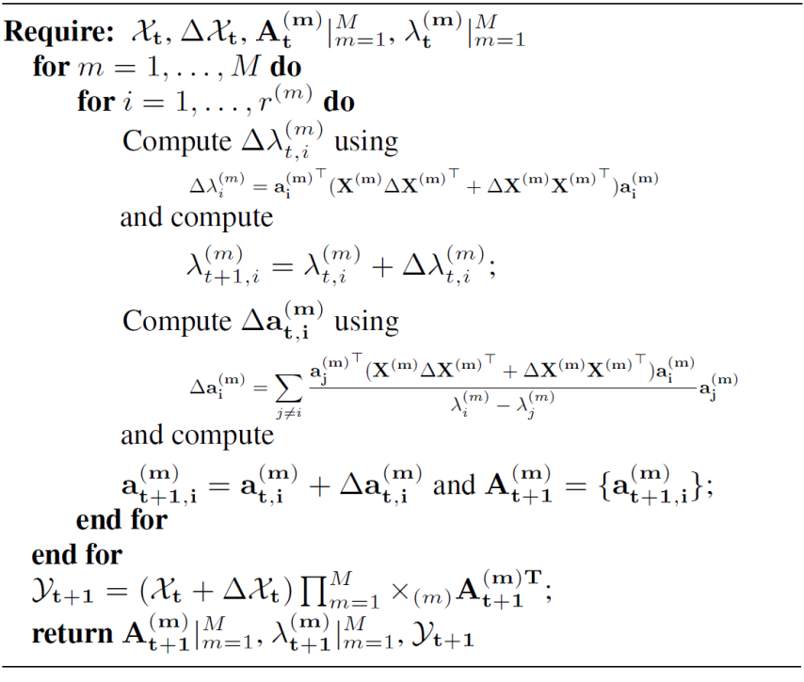
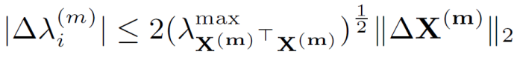
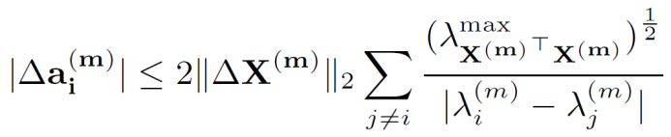
FEMA Algorithm
Approximation
Bound Guarantee
core tensor
projection matrix
Notes:
FEMA algorithm gives how to approximate the updated core tensor and projection matrices. It also gives bounds to guarantee the performance of approximation.

Slide 19
Outline
1. Background
2. Model Formulation
3. The Framework
4. Experiments
5. Visualization
Notes:
Let’s now see the experiments.

Slide 20
Experiments: Test Behavior Prediction
Data sets
Leveraging multi-faceted information
Leveraging flexible regularizations
Efficiency, loss and parameters
Notes:
We show the performance of predicting human behaviors. I will first show our data sets. Then we check the usefulness of leveraging multi-faceted information and flexible regularizations. The last will be efficiency, loss and robustness to parameters.

Slide 21
Data Sets
Microsoft Academic Search
Subset of top 100 experts from query “data mining”
Paper: <author, affiliation and keyword>
Regularization: co-authorship <author, author>
7,777 x 651 x 4,566 x 32 years: 171,519 tuples
Tencent Weibo
43 days: Nov. 9, 2011 to Dec. 20, 2011
Tweet: <user-who-@, @-ed-user, word>
Regularization: social relation <user, user>
6,200 x 1,813 x 6,435 x 43 days: 519,624 tuples
Notes:
We use two data sets. One is from Microsoft Academic Search. We first search “data mining” and get the top 100 experts. Then we crawled their papers and information through 32 years. The dimensions in this tensor are author, affiliation and keyword. Every entry is the number of papers. The regularization is co-authorship matrix. \\
The other is from Tencent Weibo in 43 days. The behavior is that users can @ their friends in tweets. So, we have user who @ others, users who are @-ed and words in their tweet. The regularization is social relation matrix.

Slide 22
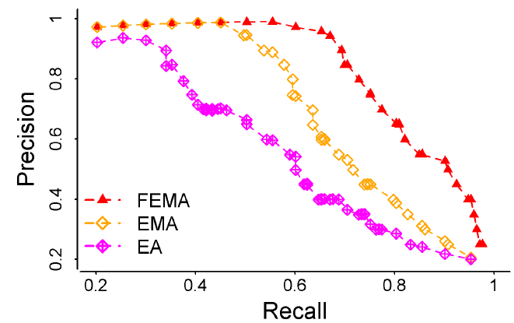
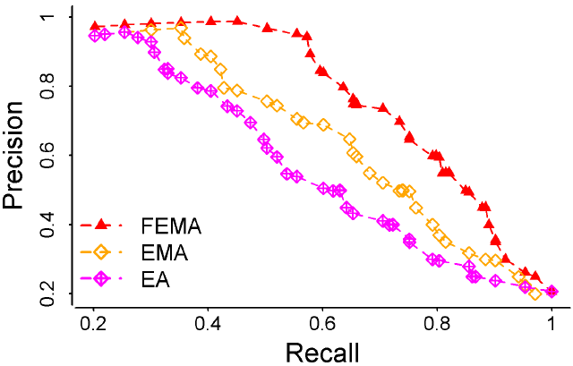
Leveraging Multi-faceted Information
Predict “Who”-“What keyword”
FEMA uses “Where” (affiliation).
Predict “Who”-“@Whom”
FEMA use “What” (tweet word).
 | Microsoft Academic Search |  | Tencent Weibo
 | MAE | RMSE | MAE | RMSE
FEMA | 0.735 | 0.944 | 0.894 | 1.312
EMA | 0.794 | 1.130 | 0.932 | 1.556
EA | 0.979 | 1.364 | 1.120 | 1.873
Precision vs Recall
X
L
X
X
Notes:
Now we try to predict who write paper about what keyword, and predict who use @ to mention whom. It’s a prediction task between two dimensions. We want to know if multi-faceted information can help, in other words, if tensor is better than matrix. Here we can see MAE and RMSE of FEMA and EMA which use tensors are smaller than EA that uses just matrix. The precision and recall are also better.

Slide 23
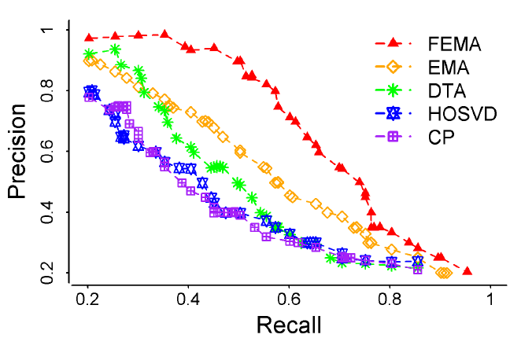
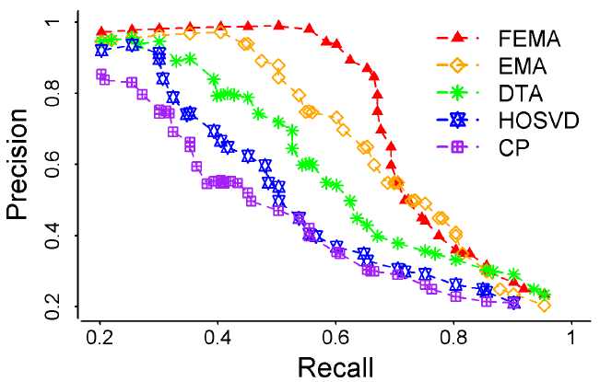
Leveraging Flexible Regularizations
“Who”-“Where”-“What keyword”?
“Who”-“@Whom”-“What”?
 | Microsoft Academic Search |  | Tencent Weibo
 | MAE | RMSE | MAE | RMSE
FEMA | 0.893 | 1.215 | 0.954 | 1.437
EMA | 0.909 | 1.466 | 0.986 | 1.698
DTA [Sun et al.] | 0.950 | 1.556 | 1.105 | 1.889
Precision vs Recall
X
L
X
Notes:
Now let’s see if auxiliary knowledge, or flexible regularizations can help. We predict the missing entries in tensors. We can see our method FEMA which uses the regularizations from co-authorship and social relation works better than those tensor-based methods that do not incorporate auxiliary knowledge.

Slide 24
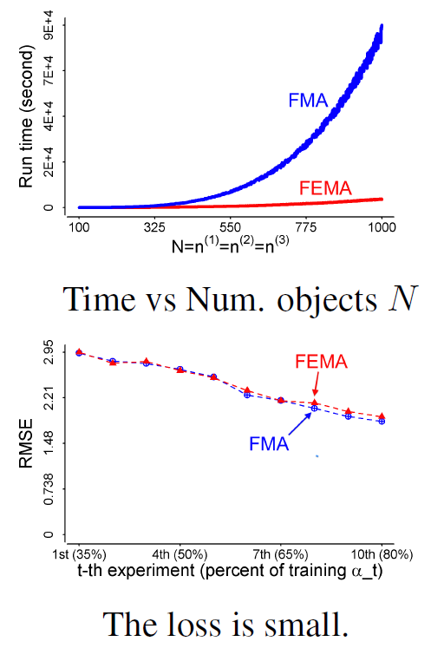
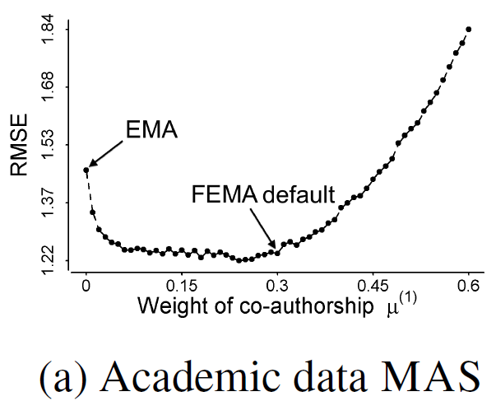
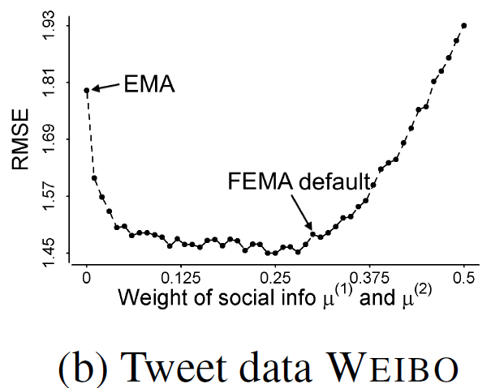
Efficiency, Loss and Parameters
Re-decompose
updated matrices
Insensitive to
regularization weight
Evolutionary analysis:
update λ and a with ΔX
Evolutionary analysis:
update λ and a with ΔX
Re-decompose
updated matrices
Notes:
The time cost is much less if we do evolutionary analysis instead of re-decomposing the updated tensors, while the loss is not much. We have given bound to guarantee this. \\
We also test the robustness to regularization weights in the two datasets. The RMSE curves show FEMA is insensitive to the weights.

Slide 25
Outline
1. Background
2. Model Formulation
3. The Framework
4. Experiments
5. Visualization
Notes:
Now let’s see some visualization results for pattern discovery.

Slide 26
Visualization: Test Pattern Discovery
Microsoft Academic Search
Tencent Weibo (see our paper ☺)
Behavior Patterns
Multi-faceted
Dynamic
Notes:
We want to see if FEMA can catch the multi-faceted and dynamic behavior patterns. I will show what we find in MAS but for Weibo, if you are interested, please read our paper.

Slide 27
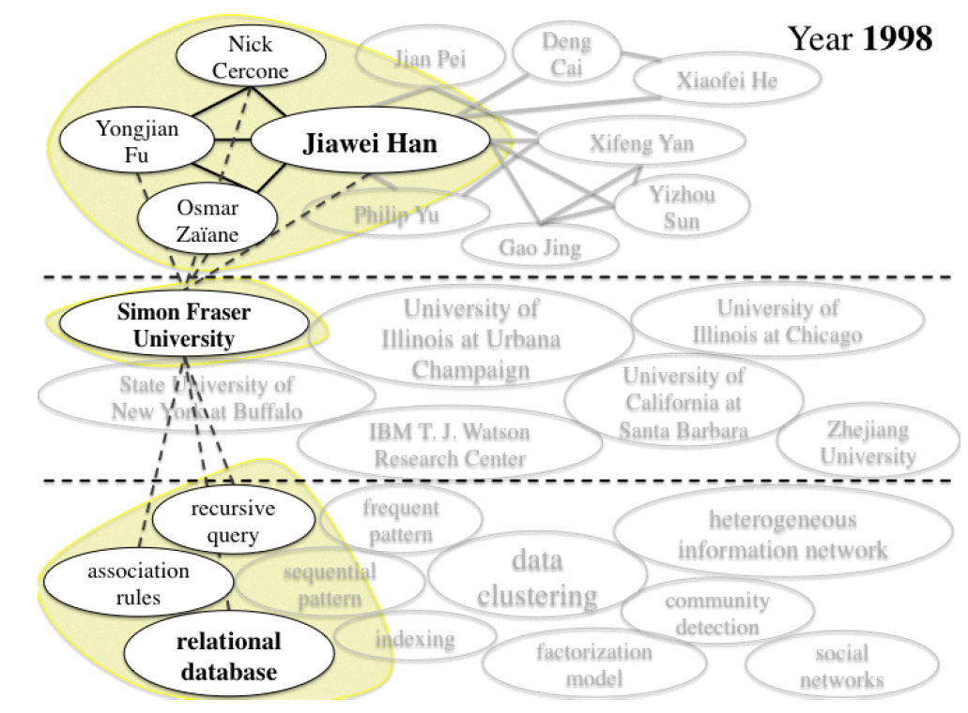
Microsoft Academic Search
Notes:
Here we show the largest author clusters in our MAS dataset. The author who has the largest value is Prof. Jiawei Han. The values in author, affiliation and keyword vectors change over time. In 1998 when he was in Simon Fraser, relational database was his main interest. He had papers about association rules and recursive query.

Slide 28
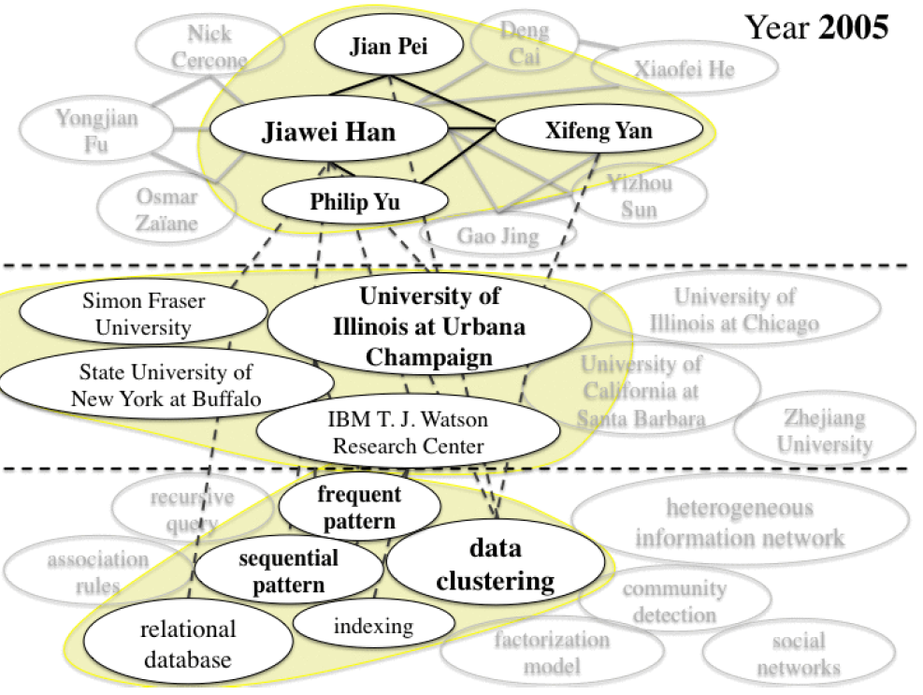
Microsoft Academic Search
Notes:
In 2005, Jiawei Han has been a professor in UIUC and he focused on data clustering and frequent pattern mining.

Slide 29
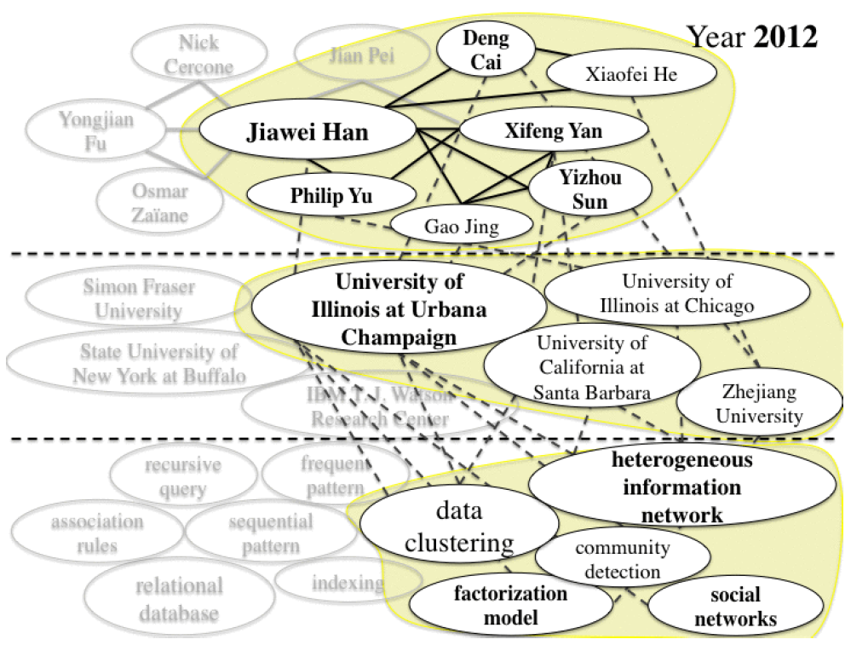
Microsoft Academic Search
Notes:
In 2012, he worked more on heterogeneous information network and social networks. His relevant affiliations and co-authors are different from those in 2005.

Slide 30
Conclusion
Human behavior: multi-faceted and dynamic
Challenges: high sparsity and high complexity
Solutions: flexible regularizations & evolutionary analysis
FEMA: approximation algorithm and bounds
Experiment: behavior prediction
Visualization: pattern discovery
Notes:
Here are the conclusions. Human behavior is multi-faceted and dynamic. We are facing two challenges when we model human behaviors. One is sparsity, the other is complexity. We use flexible regularizations and evolutionary analysis to solve them. We give framework FEMA with an approximation algorithm and bounds. We conduct experiments on behavior prediction and visualizations on pattern discovery.

Slide 31
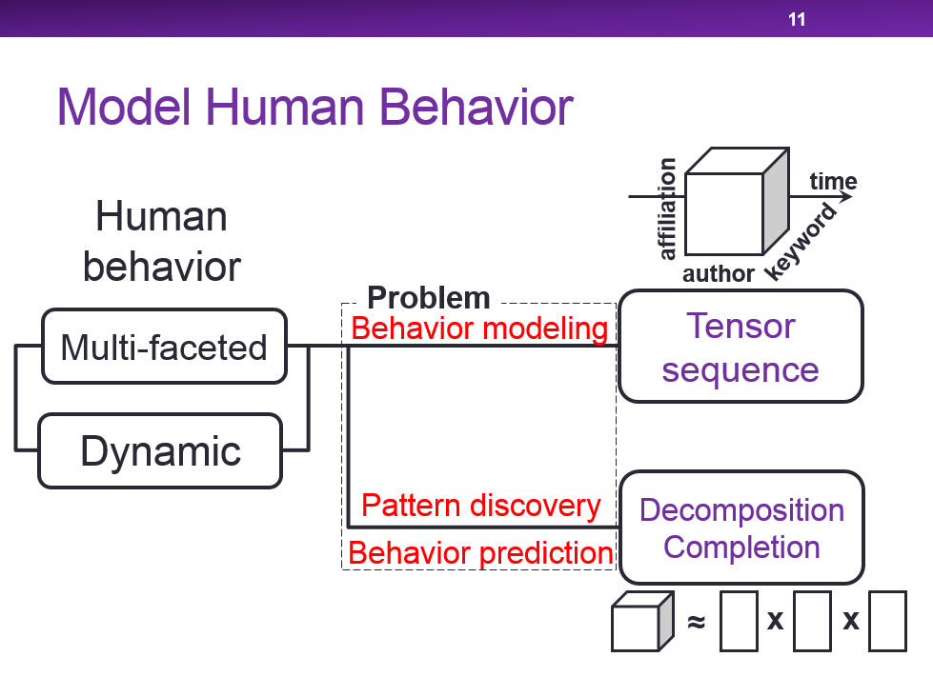
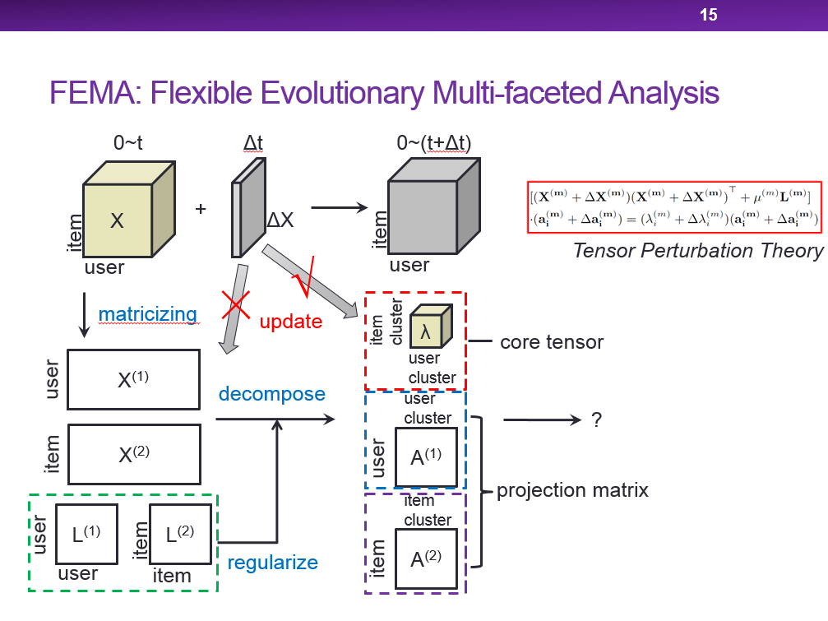
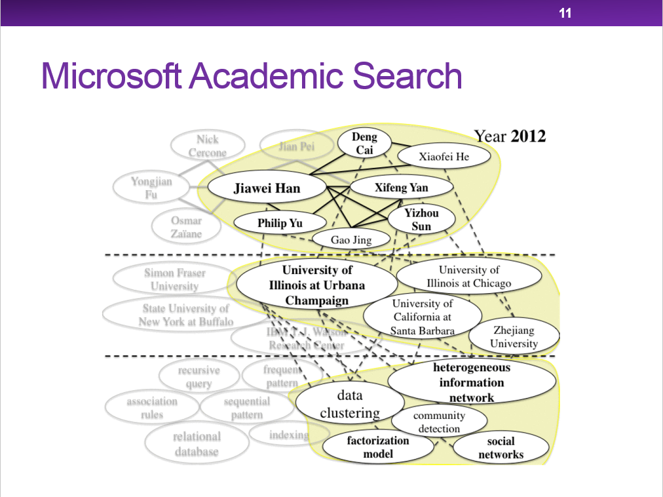
Questions?
Meng Jiang
mjiang89@gmail.com
http://www.meng-jiang.com
Notes:
That’s all. Thank you for listening. I am happy to answer your questions now.

